Slide 1
Chapter - 5 Network Layer
Prepared By:
Prof. Vishal A. Polara
Assistant Professor
Information Technology Department
Birla Vishvakarma Mahavidyalaya Engineering College

Slide 2
Outline
Design Issues
Routing Algorithms: Shortest Path routing, Flooding, Distance vector routing, Link state routing, Broadcast, multicast routing
Congestion Control Algorithms
Quality of Service, Internetworking
IPv4 and IPv6.

Slide 3
1. Network Layer Design Issues
Following issues are possible while designing network
Store-and-Forward Packet Switching
Services Provided to the Transport Layer
Implementation of Connectionless Service
Implementation of Connection-Oriented Service
Comparison of Virtual-Circuit and Datagram Subnets

Slide 4
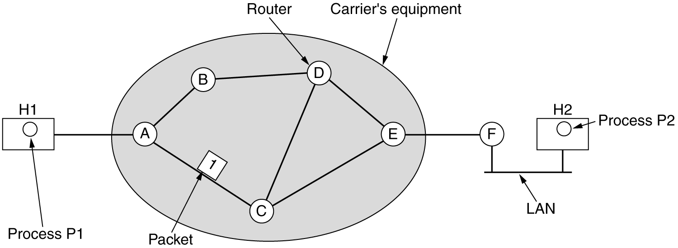
Store-and-Forward Packet Switching
In this type of network router stores packet and forward it to the appropriate destination.
fig 5-1

Slide 5
Services Provided to the Transport Layer
Services should be independent of router technology.
The transport layer should be shielded from (covered with) number, type and topology of routers present.
The network addresses made available to transport layer should use a uniform numbering plan, even across LANs and WANs.

Slide 6
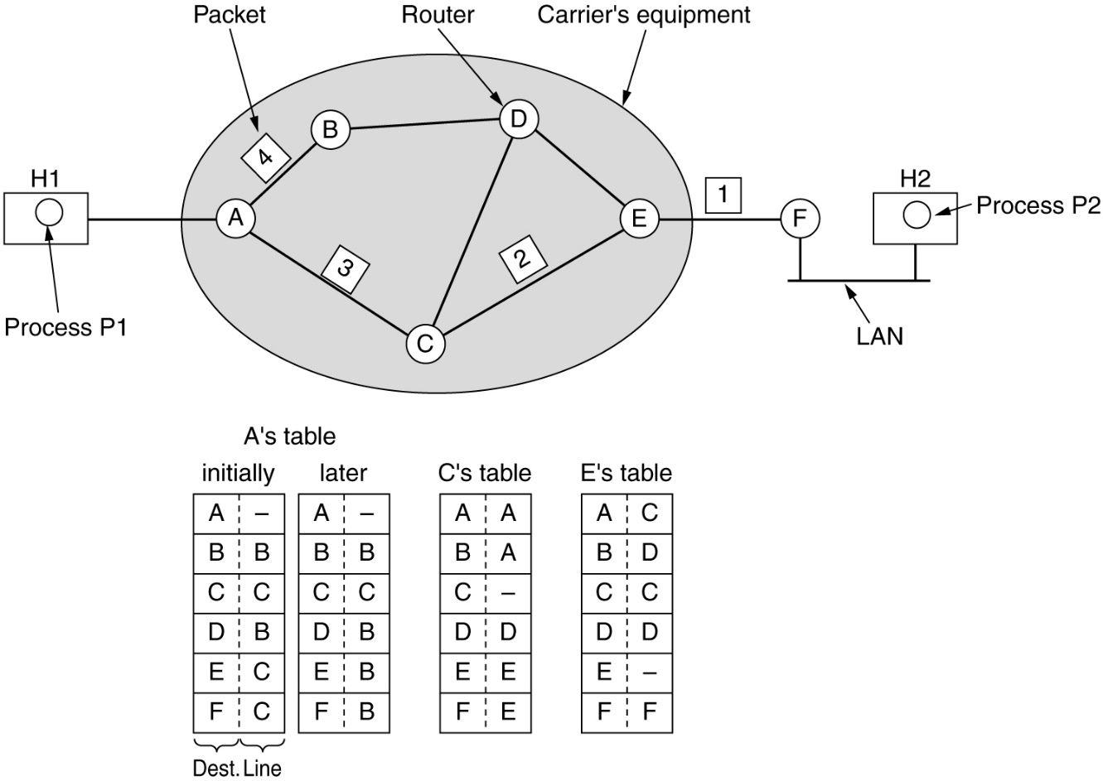
Implementation of Connectionless Service
Routing within a diagram subnet.

Slide 7
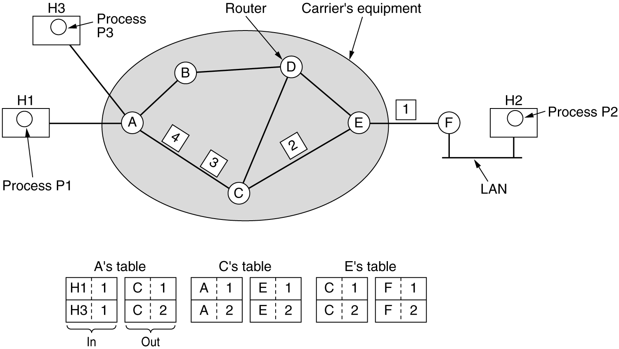
Implementation of Connection-Oriented Service
Routing within a virtual-circuit subnet.

Slide 8
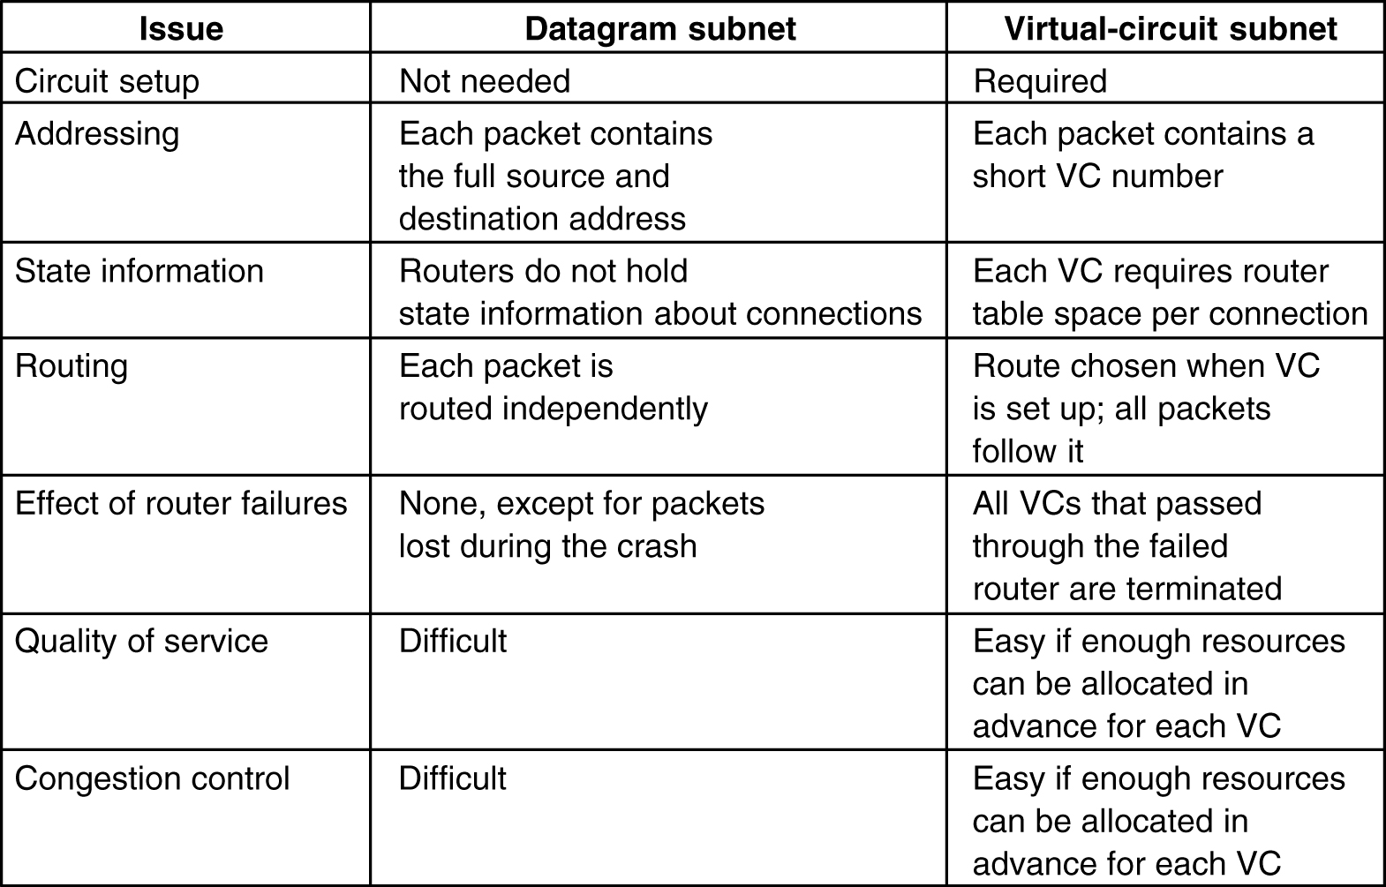
Comparison of Virtual-Circuit and Datagram Subnets
5-4

Slide 9
2. Routing Algorithm
Static Algorithms (Non-Adaptive)
Shortest-path routing.
Flooding.
Dynamic Routing (Adaptive Routing)
Distance vector routing.
Link state routing.

Slide 10
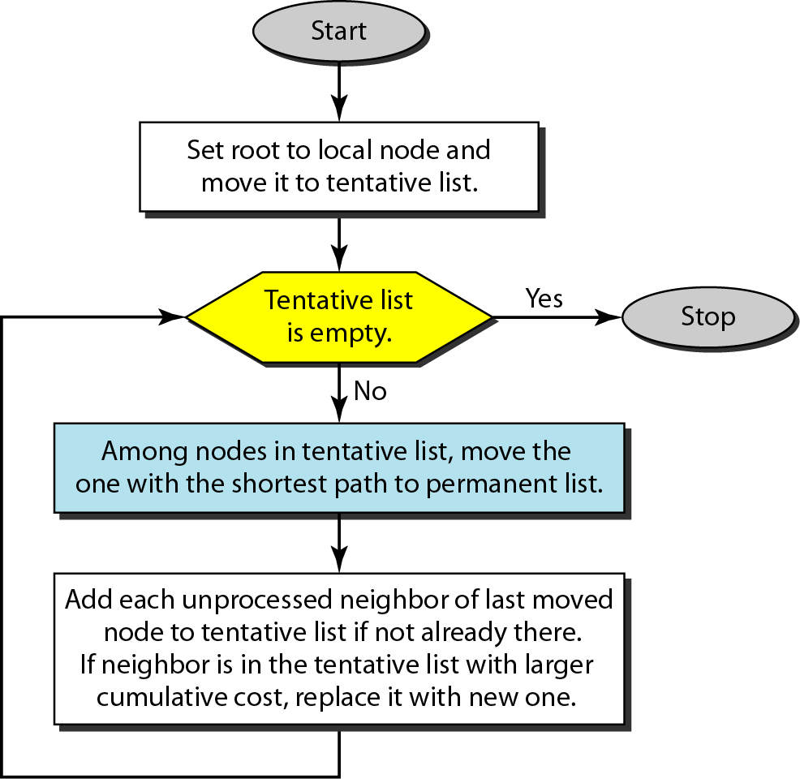
2.1 Shortest Path Routing
Also known as Dijkstra algorithm
Path length is measured using:
Number of hops
Geographic distance
Other metrics like mean queueing and transmission delay

Slide 11
Steps
It is non adaptive (static) routing algorithm.
In this algorithm initially distance from each node is infinite.
In this algorithm nodes divide into two sets: tentative and permanent.
It finds the neighbors of a current node, makes them tentative, examines them and if they pass the criteria makes them permanent.
After reaching the destination algorithm stop.

Slide 12
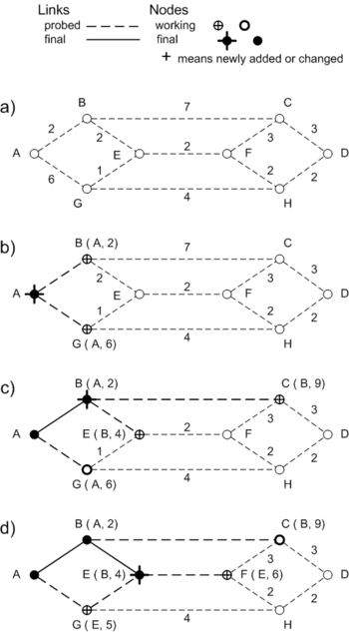
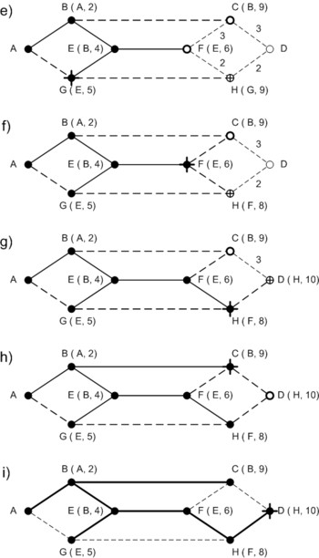
Shortest Path Routing

Slide 13
2.2 Flooding
It is static routing algorithm.
Each router must have details of adjacent router.
Sends data packet to all router except the one form where data come.
Many duplicate packet will be arrived at destination end to eliminate this use counters at hops
Problem: duplicates
Constraining the flood:
Sequencing – Each packet is uniquely numbered at the source.
Hop count – Each time a node passes on a packet, it decrements the value by one. When its value becomes ‘0’, the packet is discarded. Hop count is equal to total numbers of node from source to destination.
Selective flooding – Exclude unreasonable links

Slide 14
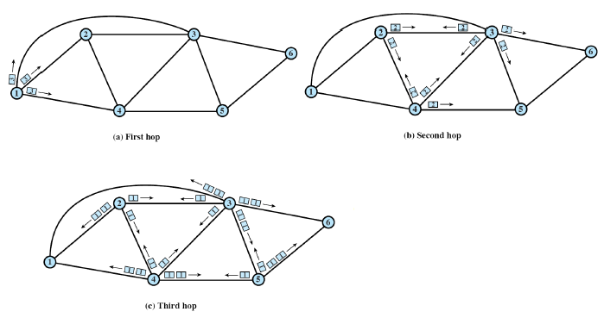
Flooding Example

Slide 15
2.3 Distance Vector Routing
It is dynamic routing (adaptive) algorithm.
In this algorithm each router maintain routing table. This tables are updated by exchanging information with the neighbors.
It is also known as bell men ford and ford-fulkerson algorithm.
In distance vector routing, each router maintains a routing table indexed by, and containing one entry for, each router in the subnet. This entry contains two parts: the preferred outgoing line to use for that destination and an estimate of the time or distance to that destination.
Metric is hop, queue and delay.

Slide 16
2.3 Distance Vector Routing
It has three step: initialization, sharing, updating
During initialization each node know how to reach all other node which is immediately connected to it.
During sharing phase each node share their routing table to other node so other node can decide how to reach all the node which is not directly connected to it.
During updating phase each node update distance to the node which is not directly connected to it and add entry in third column (it will add entry of source node).
Node will create modified table from neighbor node and compare with old one and keeps the shortest one.

Slide 17
2.3 Distance Vector Routing
When to share?
Periodic update: a node sends its routing table, normally every 30s, in a periodic update.
Triggered update: a node sends its two column routing table to its neighbors anytime there is a change in its routing table. This is called triggered update.
A node receives a table from a neighbor, resulting in changes in its own table after updating.
A node detects some failure in the neighboring links which results in a distance change to infinity.

Slide 18
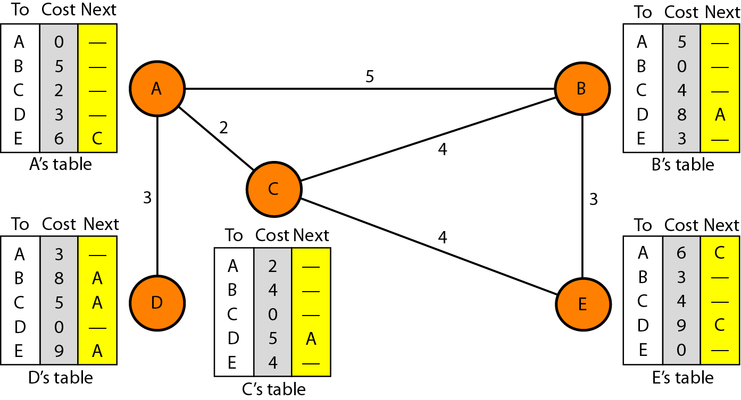
Figure Distance vector routing tables

Slide 19
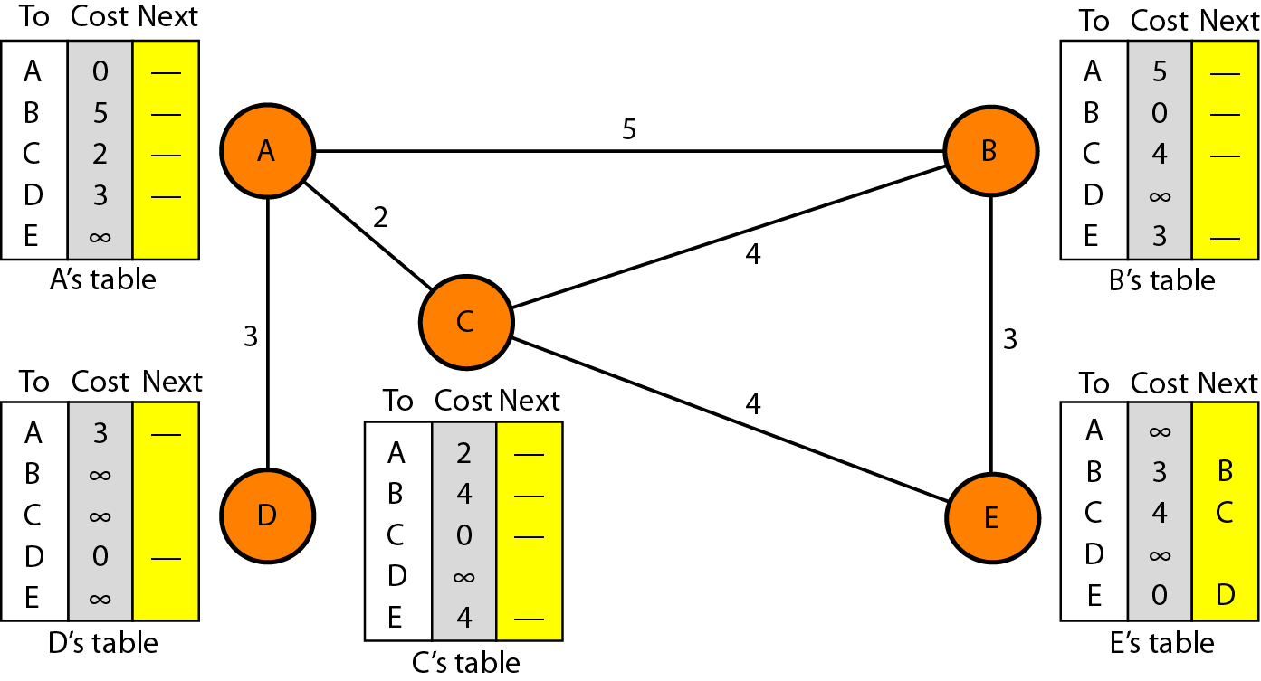
Figure Initialization of tables in distance vector routing

Slide 20
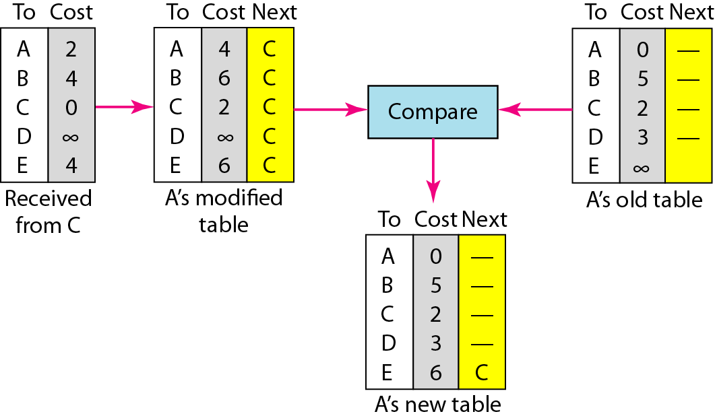
Figure Updating in distance vector routing

Slide 21
2.3 Distance Vector Routing Problem &sol.
Two Node instability:
If there are two node at the A and B who knows how to reach X at beginning. Now the link between A and X fails. Node A changes its table , if A can send its table to B immediatelly, everythin is fine.
For ex. X----A----B is connection
But if B sends its routing table to A it will create a problem , here A assumes that there is a path from B to X. now A send its routing table to B so cost of reaching X increases gradually until it reaches infinity.
Solution:
Defining Infinity:
Define distance between each node is 1 and 16 as infinity that means it cannot use for large system. The size of the network in each direction cannot exceed 15 hops.

Slide 22
2.3 Distance Vector Routing solution
Split Horizon: Another solution is called split horizon. If according to its table node B think that optimum path to reach X from A then it will not advertise this information to A. it comes from A.
Split Horizon and poison reverse:
The distance vector protocol uses a timer, and if there is no news about a route, the node deletes the route from its table. when node B in the previous scenario eliminate the route to X from its advertisement to A. here node B still advertise the value for X but with value as infinite that means value comes from A.

Slide 23
2.3 Distance Vector Routing prob & sol.
Three node instability: in this case no guarantee of stability.
X—A---B ----C-----A
If X is not reachable node A send this to B and C , B will receive and update table but C will not receive so it assume that there is a path to X . C sends its routing table to B, B is fooled here so it update table there is a route from C, after a while B advertise to A and A will be fooled.
Now loop continues. The loop stops when the cost in each node reaches infinity.

Slide 24
2.4 Link State Routing
Each router must do the following:
Discover its neighbors, learn their network address.
Measure the delay or cost to each of its neighbors.
Construct a packet telling all it has just learned.
Send this packet to all other routers.
Compute the shortest path to every other router.
Dijkstra’s algorithm is run to find the shortest path to each routers.

Slide 25
1.Learning About the neighbors
In this step router will learn about its neighbors.
It send hello message to all other node on point to point line. Then the router on the other end is expected to send back a reply telling who it is.
These names must be globally unique because when a distant router later hears that three routers are all connected to F, it is essential that it can determine whether all three mean the same F.
When two or more routers are connected by a LAN, the situation is slightly more complicated.

Slide 26
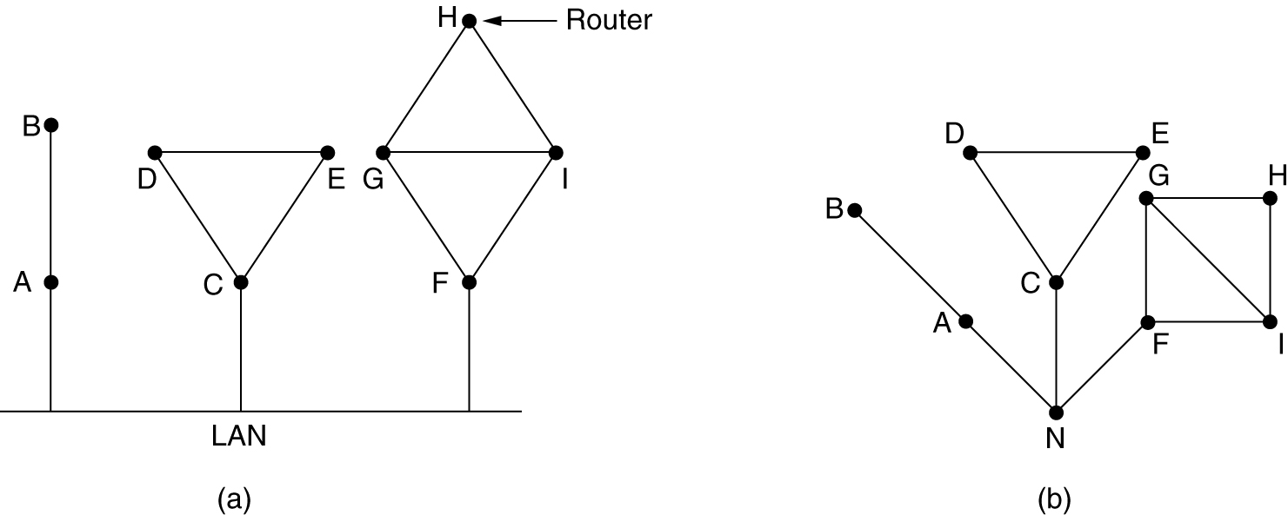
Learning about the Neighbors
Nine routers and a LAN.
A graph model of (a).

Slide 27
2.Measuring line cost
In this step router will calculate delay to its neighbors.
Each router will send ECHO packet to calculate delay. When this packet comes back at source it will divide total time by 2 and note down the time as delay.
It is also calculated based on delay between to two line heavily loaded and lightly loaded. It will select line which is lightly loaded.
In the figure CF path is longest and EI is smallest so all traffic follows EI path.

Slide 28
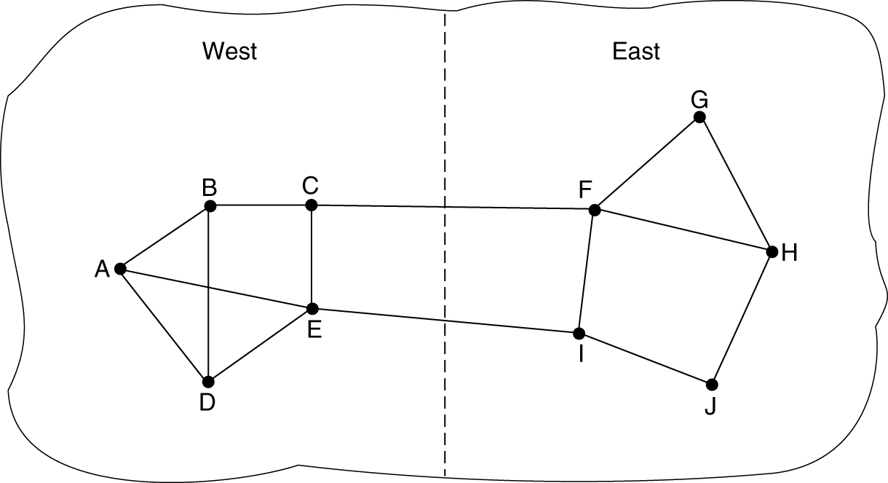
Measuring Line Cost
A subnet in which the East and West parts are connected by two lines.

Slide 29
3. Building Link State packets
After Collecting all the information each router to build packet containing data.
Packet start with identity of sender, followed by sequence number and age, and list of neighbors. For each neighbor delay is also given.
It is easy to build packet but it is difficult to determine when to build.
Normally it is build periodically at regular intervals. Another way to build them when some significant event occurs. Such as line or neighbor going down.

Slide 30
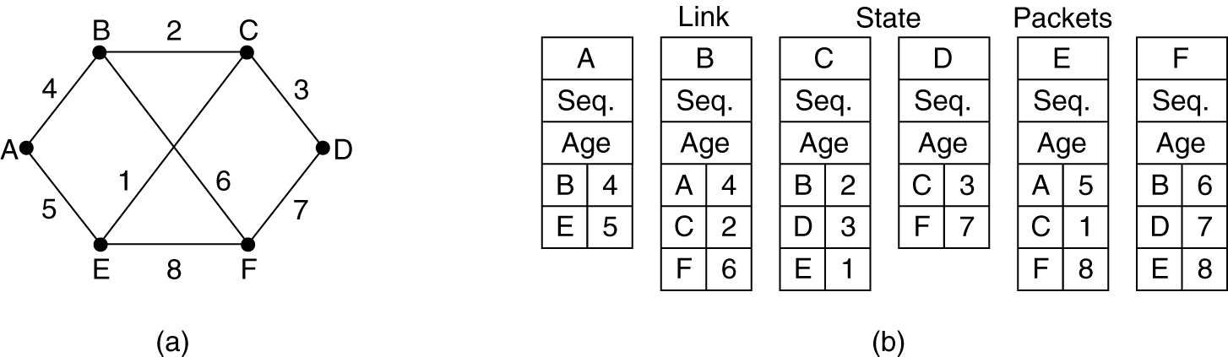
Building Link State Packets
(a) A subnet. (b) The link state packets for this subnet.

Slide 31
4. Distributing the link state packets
Fundamentally flooding is used to distribute packets. It keeps track of all packet and source. It will check packet if it is new then it will forward to all except one from whom it comes. If duplicate it is discarded.
First problem is sequence number wrap around or completed.
Second problem if router get crashed, it will lose track of sequence numbers. If it start with 0 next packet will be rejected as a duplicate.
Third problem is if sequence number is corrupted.
Solution of this problem is adding age after sequence number which is decremented once per second. When age hits 0 information from that router is discarded.

Slide 32
5. Computing the new routes
Once a router has accumulated a full set of link state packets, it can construct the entire subnet graph because every link is represented.
Dijkstra's algorithm can be run locally to construct the shortest path to all possible destinations

Slide 33
2.5 Broadcast Routing
It is the process of “Sending a packet to all destinations simultaneously”. Various methods are:
Send packet to each destination
Flooding – point-to-point routing algorithm
Multidestination routing – new packet for each output line to be used. (Each output line will contain the destination address that are to use that line)
A spanning tree - is a subset of the subnet that includes all the routers but contains no loops
Reverse path forwarding

Slide 34
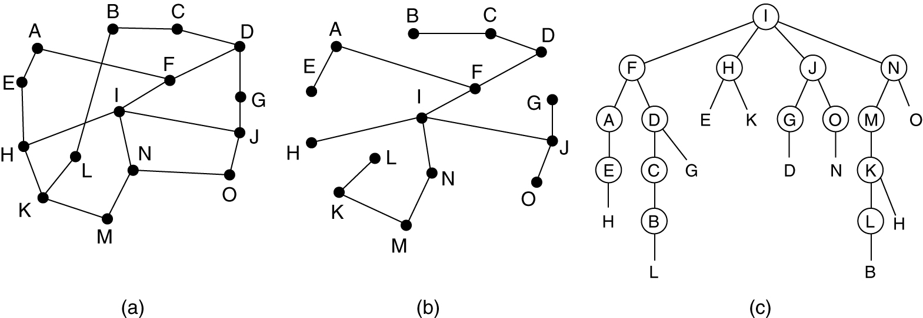
Broadcast Routing
Reverse path forwarding
(a) A subnet. (b) a Sink tree. (c) The tree built by reverse path forwarding.

Slide 35
2.6 Multicast Routing
It is used when all are not interested to receive the message.
In this technique there are group of router and message will be send to specific group only.

Slide 36
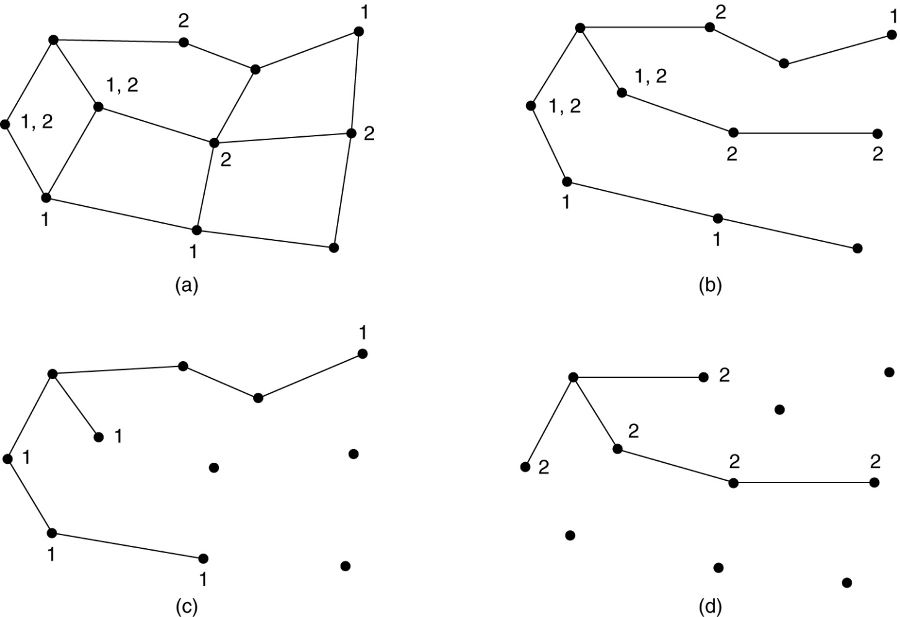
2.6 Multicast Routing
(a) A network. (b) A spanning tree for the leftmost router. (c) A multicast tree for group 1. (d) A multicast tree for group 2.

Slide 37
3. Congestion Control
Congestion control refers to techniques and mechanisms that can either prevent congestion, before it happens, or remove congestion, after it has happened.
In general, we can divide congestion control mechanisms into two broad categories:
open-loop congestion control (prevention): It is applied to prevent congestion before it happens.
closed-loop congestion control (removal): it is applied to alleviate congestion after it happens.

Slide 38
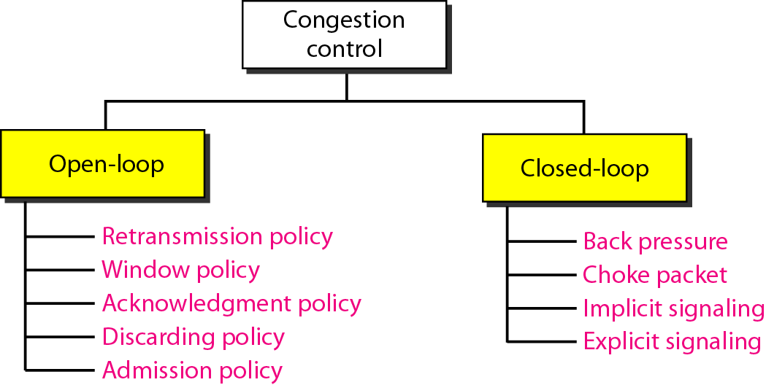
Figure Congestion control categories

Slide 39
Open Loop Congestion control
1. Retransmission Policy: Retransmission can create congestion when packet get lost. To prevent it retransmission times must be designed to optimize efficiency and at the same time prevent congestion.
2. Window policy: the type of window also create congestion. It is better to use selective repeat instead of go back N.
3. Acknowledgement Policy: the acknowledgment by receiver also affect congestion. In this case receiver will not send acknowledgement for every packet it receive which will slow down the receiver.
4. Discarding Policy: packet must me discarded by router to prevent congestion. For example in audio transmission less sensitive packets is discarded when congestion occurs.
5. Admission Policy: In this case router will check all resources before establishing virtual circuit. If there is congestion it will not allow to get admission in circuit.

Slide 40
Close Loop Congestion control
1. Backpressure: In this technique congested node stops receiving data from the immediate upstream node or nodes.
Backpressure is a node to node congestion control that starts with a node an propagates, in the opposite direction of data flow.
It is applied only to virtual circuit network. In which each node knows the upstream node from which a flow of data is coming.
2. Chock Packet: A choke packet is a packet sent by a node to the source to inform it of congestion.
In chock packet method the warning is from the router which has encountered congestion, to the source station directly.

Slide 41
Close Loop Congestion control
3. Implicit Signaling: in this technique there is no communication between the congested node or nodes and the source.
The source guesses that there is a congestion somewhere in the network from other symptoms.
For example if source will not get an acknowledgment for a while it assumes that there is a congestion.
4. Explicit Signaling: The node that experience congestion will send signal to source or destination.
In this technique no separate packet is used , signal is included in the packets that carry data.
Backward signaling: bit sent to source in reverse direction to inform congestion
Forward signaling: bit sent in same direction to receiver

Slide 42
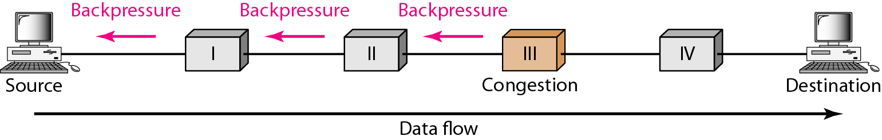
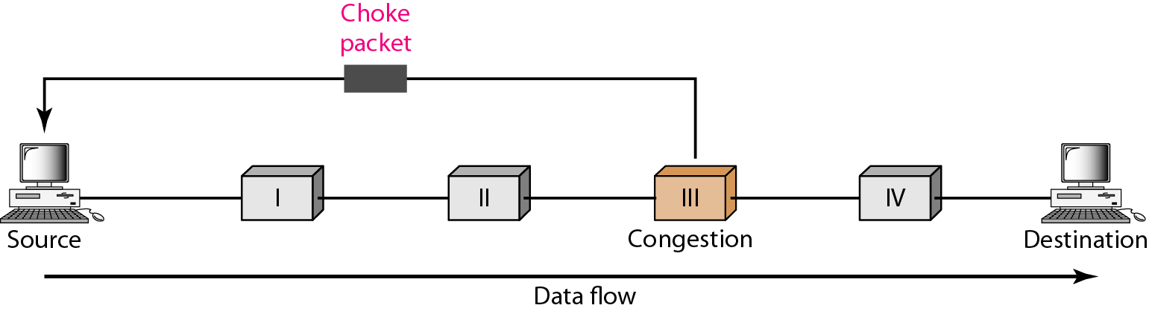
Figure Backpressure method for alleviating congestion
Figure Choke packet

Slide 43
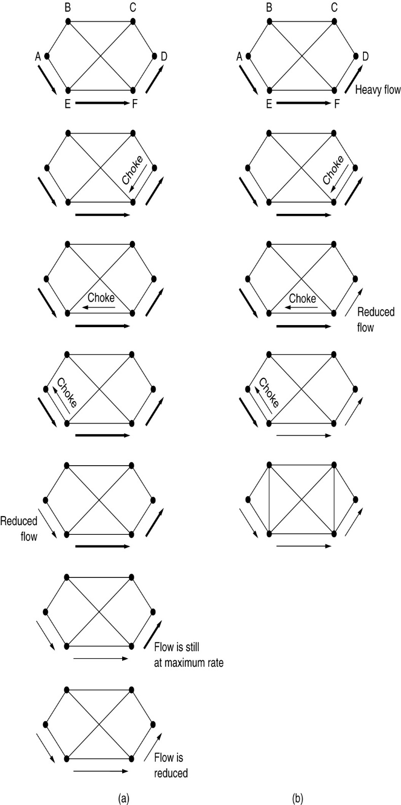
Hop-by-Hop Choke Packets
(a) A choke packet that affects only the source.
(b) A choke packet that affects each hop it passes through.

Slide 44
4. Quality of service
Flow Characteristics:
1. Reliability: It means lose of packet. If packet lose is less than reliability is more. For example it is required in mail, file transfer etc.
2. Delay: source to destination delay is not good for voice communication.
3. Jitter: Jitter is the variation in delay for packets belonging to the same flow. For example if four packet sent at 1,2,3 and 4 second it arrive at 21,22,23,24 then there is a same delay 20.
high jitter means difference between delay is large.
4. Bandwidth: different applications need different bandwidths. Video conferencing require millions of bit to sent while mail doesnot.

Slide 45
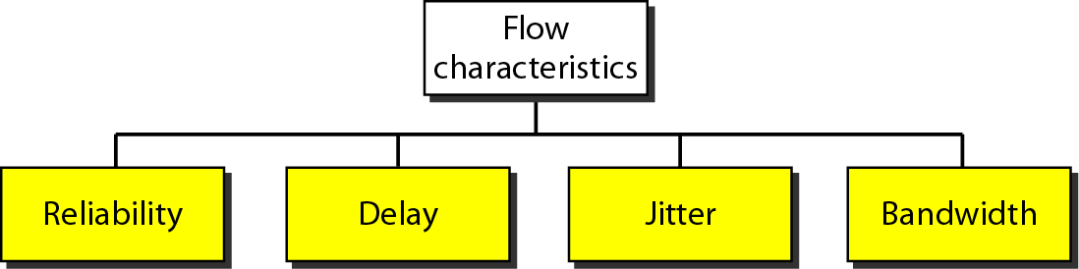
Figure Flow characteristics

Slide 46
4.1 Quality of service improved technique
1. Scheduling:
FIFO queuing: first in, first out queuing packets wait in buffer until the node is ready to process them. If the average arrival rate I higher than the average processing rate, the queue will fill up and new packets will be discarded. For example wait at bus stop.
Priority Queuing: In this technique priority class is assigned to packets. The packet in higher priority queue are processed first.
there is a drawback if there is a continuous flow in high priority queue. The packets in the lower priority queues will never a chance to be processed.
Weighted Fair Queuing: It is like priority queue class is assigned to packet but here higher priority means weight, if weights are 3,2, and 1, there packets are processed from the first queue, two from send and one from third queue.

Slide 47
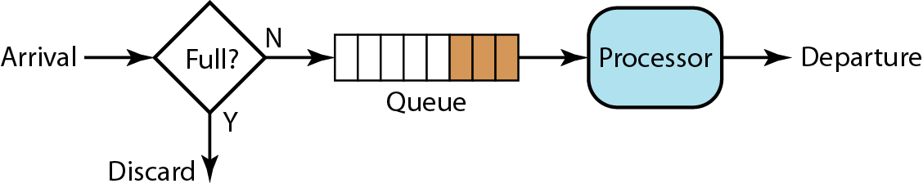
Scheduling - FIFO
Figure FIFO queue

Slide 48
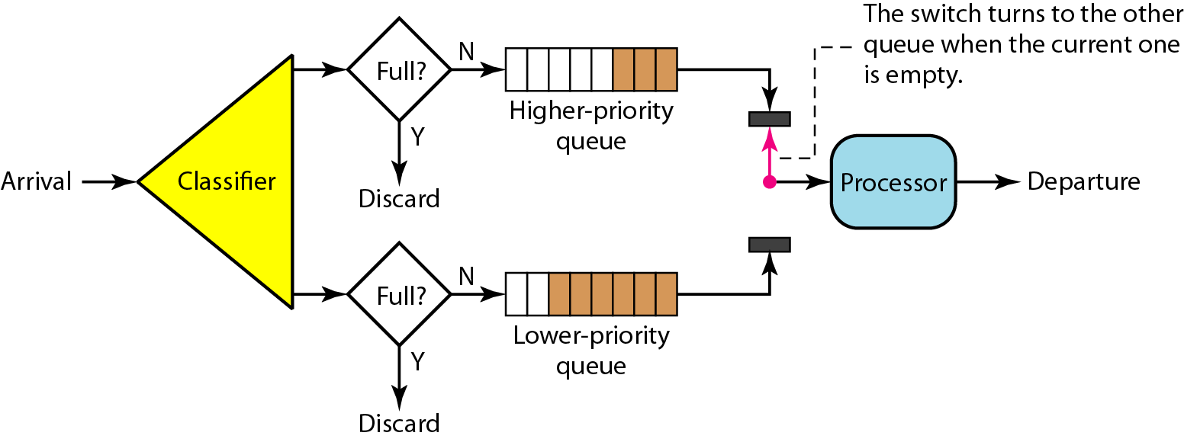
Scheduling – Priority queuing
Figure Priority queuing

Slide 49
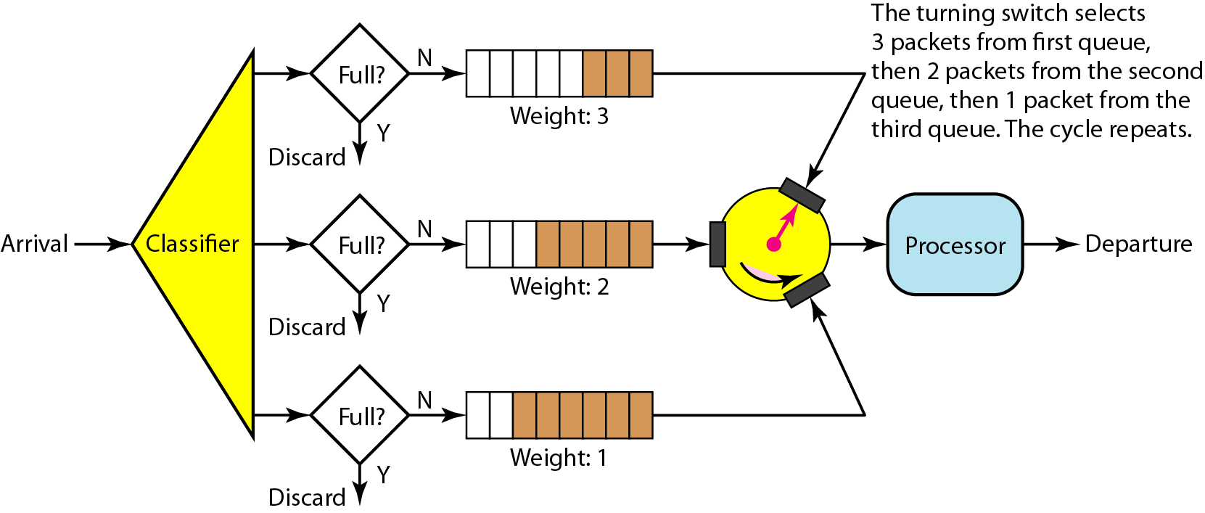
Scheduling – Weighted Fair queuing
Figure Weighted fair queuing

Slide 50
4.1 Quality of service improved technique
2. Traffic Shaping
It is a mechanism to control the amount and the rate of the traffic sent to the network.
Leaky Bucket: It is used to smooth out busty traffic.
Flow is not depend on input, output flow is constant.
Here busty chunks are stored in the bucket and sent out at an average rate.
It can also prevent congestion. It is also used for FIFO queue. If the traffic consists of fixed size packets ,the process removes a fixed number of packets from the queue at each tick of the clock. If the traffic consists of variable length packets the fixed output rate must be based on the number of bytes or bits..

Slide 51
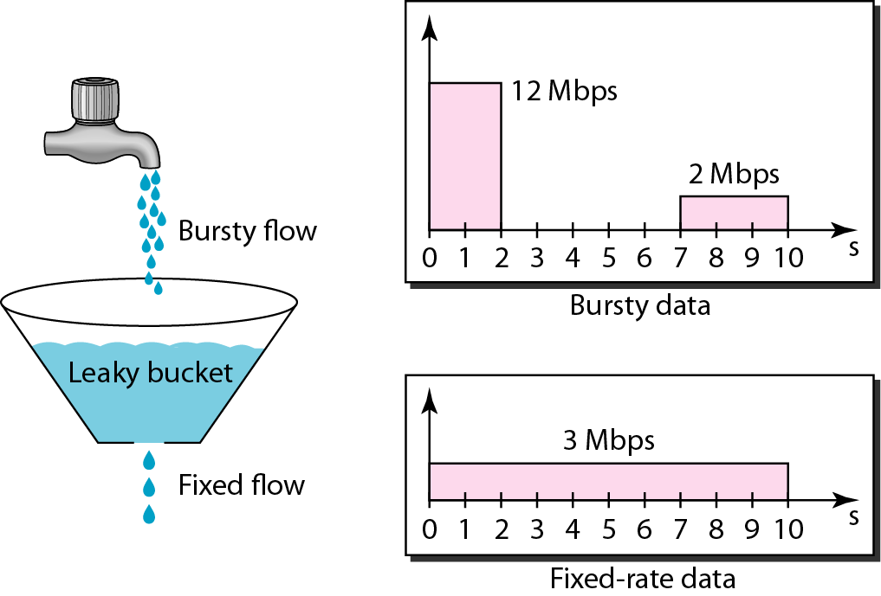
Traffic Shaping – Leaky bucket
Figure 24.19 Leaky bucket

Slide 52
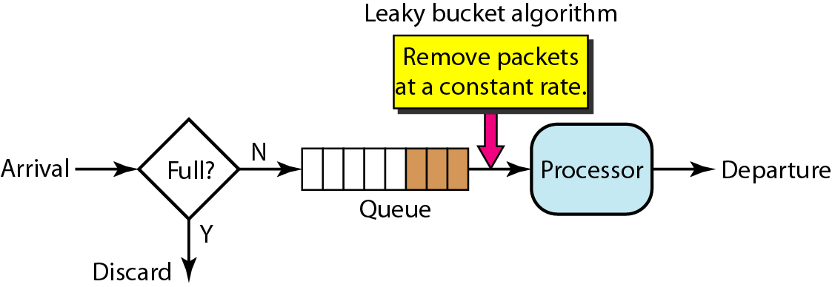
Figure Leaky bucket implementation

Slide 53
4.1 Quality of service improved technique
Token Bucket: the leaky bucket is very restrictive. It does not credit and idle host.
If host does not have data bucket becomes empty. If the host has busty data the leaky bucket allows only an average rate.
In token bucket algorithm allow idle host to accumulate credit for the future in the form of tokens.
For each tick of the clock the system sends n tokens to the bucket. The system removes one token for every cell(or byte) of data sent.
For example if n is 100 and the host is idle for 100 ticks. The bucket collect 10,000 tokens.
Here host can send busty data as long as the bucket is not empty.
It can be easily implemented using counter. Each time token is added counter in incremented by 1 and each time data is sent counter is decremented by 1.

Slide 54
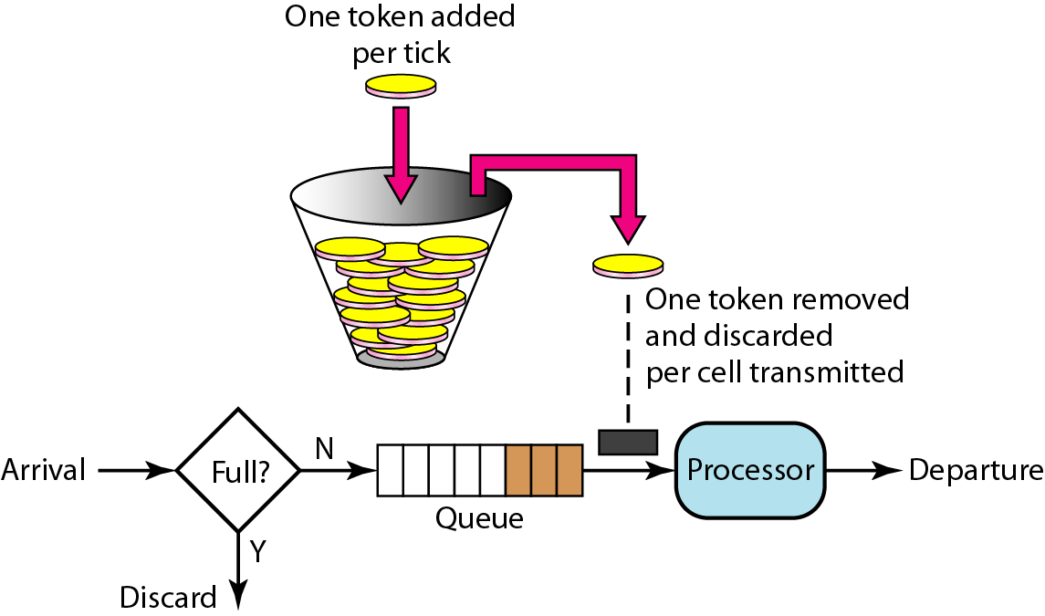
Figure Token bucket

Slide 55
4.1 Quality of service improved technique
3. Resource Reservation: A flow of data needs resources such as buffer, bandwidth, CPU time.
Quality of service improved if resources are reserve before task.
4. Admission Control: Admission control refers to the mechanism use by router or a switch to accept or reject a flow based on predefined parameters called flow specifications.
it check the availability of new connection based on load.

Slide 56
The Example Protocol – OSPF
Open Shortest Path First
Areas – Collection of networks, host and routers all contained within an autonomous system
Area Border routers
Backbone & Backbone routers
Virtual link
Area identification
Metric
Types of links

Slide 57
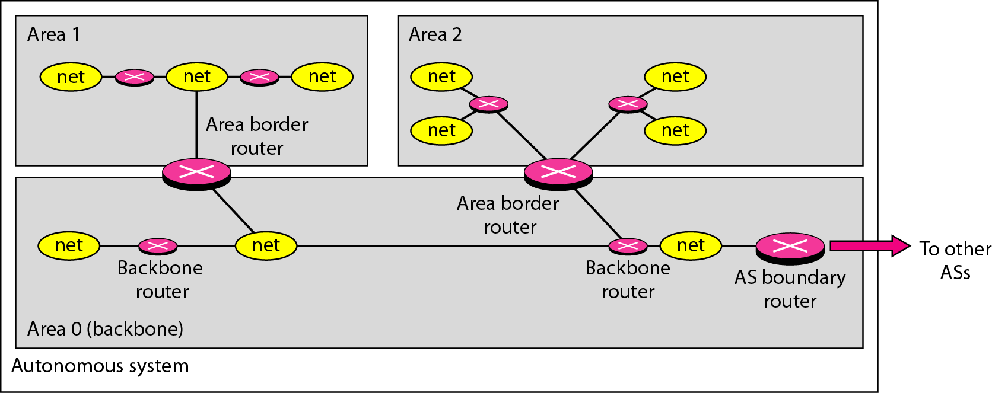
Figure Areas in an autonomous system

Slide 58
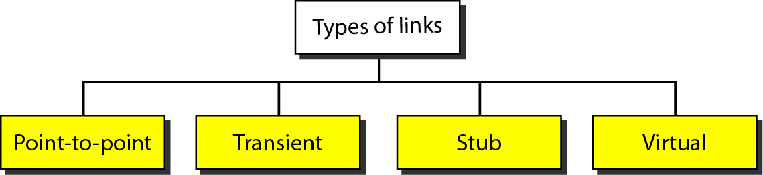
Figure Types of links

Slide 59
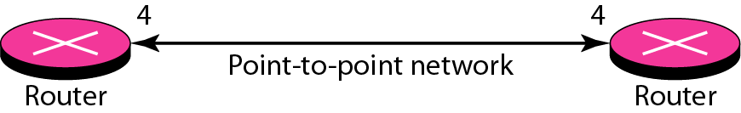
Figure Point-to-point link

Slide 60
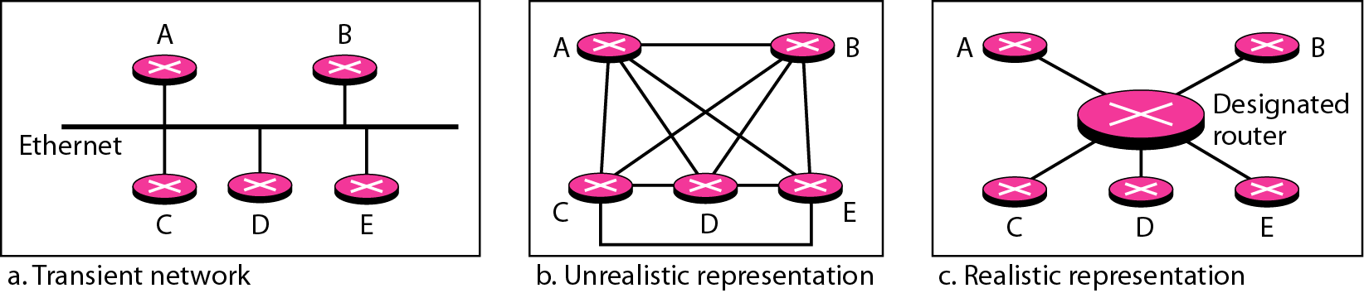
Figure Transient link

Slide 61
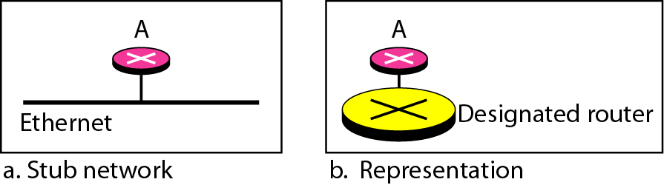
Figure Stub link

Slide 62
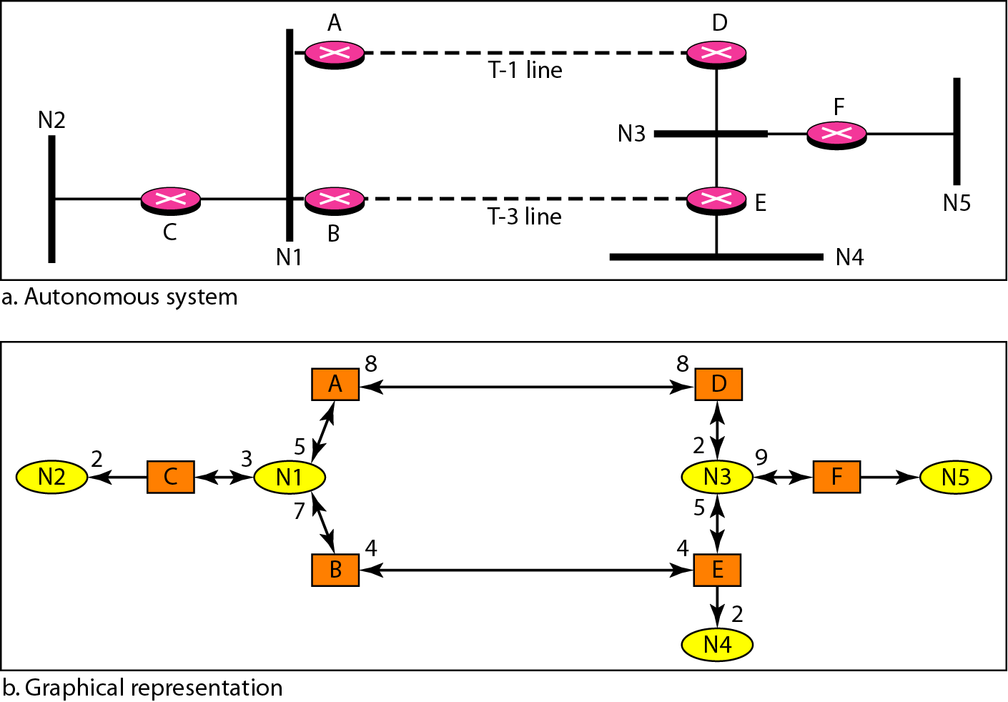
Figure Example of an AS and its graphical representation in OSPF

Slide 63
5. Internetworking (IPv4 and IPv6)
Internetwork is made of five networks: four LANs and one WAN.
Internet is made of four sub network 4 LAN and 1 WAN.
IP is connection less so it will not provide reliability.
IPv4 is also connection less it will not provide flow control and error control.
To provide reliability it must be used with TCP.

Slide 64
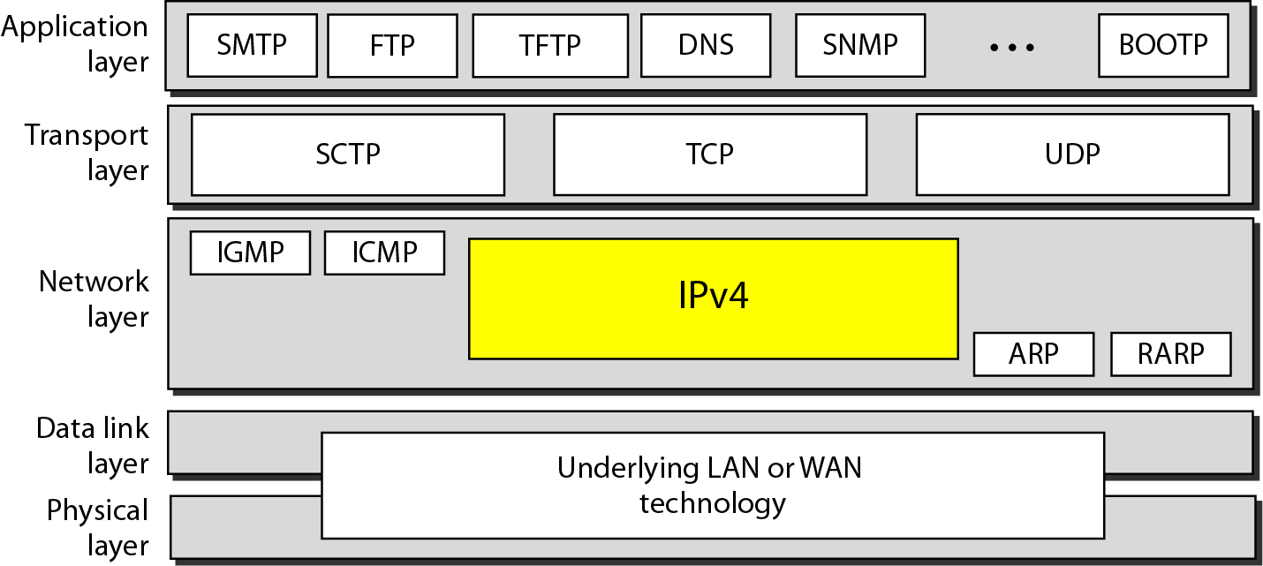
Figure Position of IPv4 in TCP/IP protocol suite

Slide 65
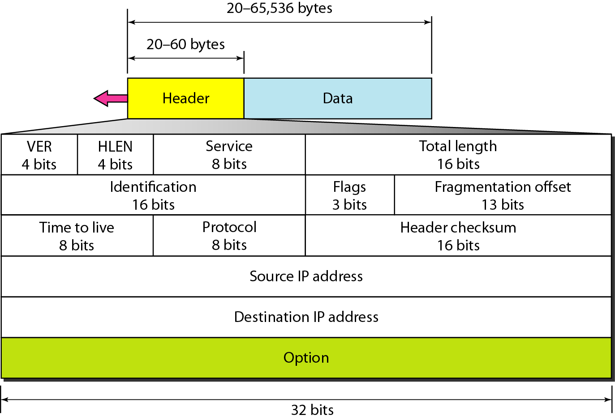
Figure IPv4 datagram format

Slide 66
IP Addresses

Slide 67
IPv4 Header
Version(VER): it is a 4 bit field defines the version of the iPv4 Protocol.
Header Length(HLEN): this 4 bit field defines the total length of the datagram header in 4 byte words.
Header length is from 20 to 60 byte so when it is minimum 20 bytes, header length is 5 (5 * 4=20).
Service: it is of 8 bit. In this interpretation first 3 bits are called precedence bits. The next 4 bits are called type of service(TOS) bits.
Precedence is used to defined priority of datagram at the time of congestion.
TOS bits with each bit have special meaning given in table.

Slide 68
IPv4 Header
Total Length: this is a 16 bit field that defines the total length of the IPv4 datagram in bytes.
Length of data is coming from upper layer can be calculated using
Length of data = total length – header length
Identification: it is 16 bit field identifies a datagram origination from source.
Flags: this is a 3 bit field. The first bit is reserved. The second bit is called the do not fragment bit. If its value is 1. don’t fragment. Third bit is called more fragment bit. If its value is 1, it means the datagram is not the last fragment, there are more fragments after this one.

Slide 69
IPv4 Header
Fragmentation offset: this is 13 bit field shows the relative position of this fragment with respect to the whole datagram.
Ex. Datagram 0 to 3999 first fragment 0 to 1399 offset is 0/8=0 , second fragment 1400 to 2799, offset is 1400/8=175 same last.
Time to live: A datagram has a limited lifetime in its travel through an internet. It holds the timestamp. It is discarded after completion of time stamp.
Protocol: it is 8 bit filed defines the higher level protocol that uses the services of the IPv4 layer.
Checksum: Use for error detection.
Source address and destination address: it is 32 bit field defines the IPv4 address of source.

Slide 70
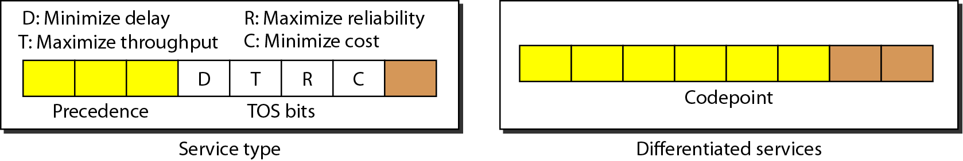
Figure Service type or differentiated services

Slide 71
Table Types of service

Slide 72
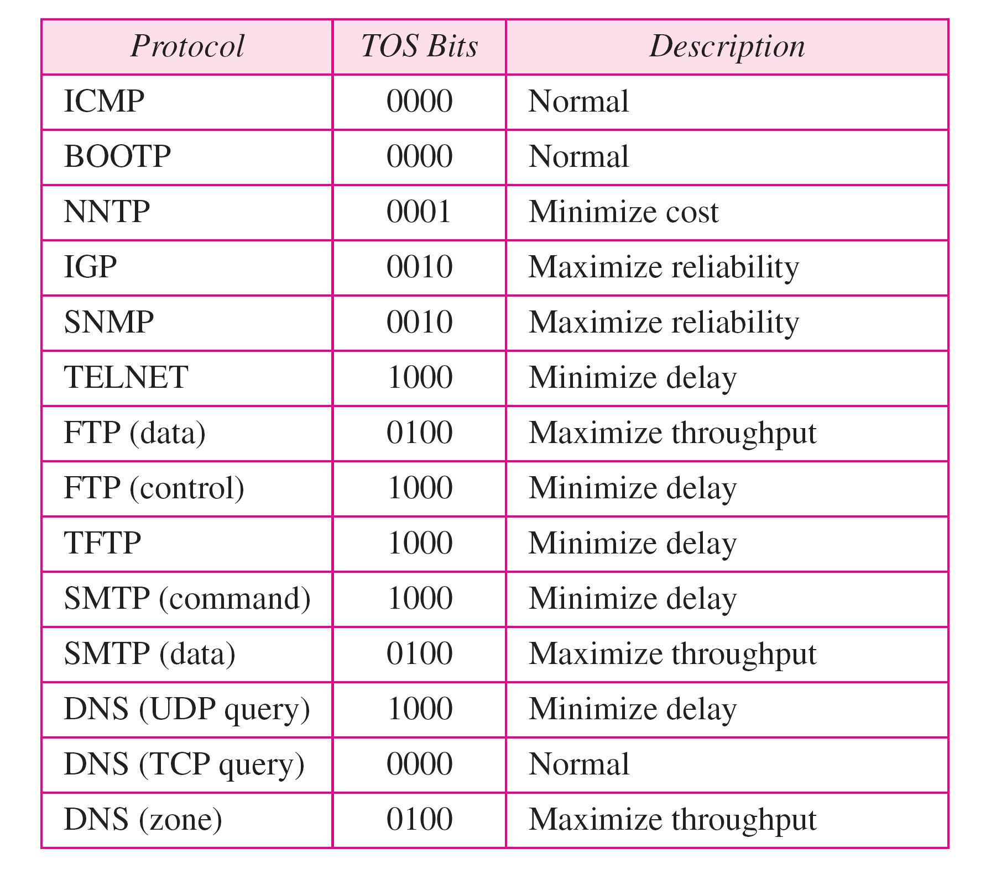
Table Default types of service

Slide 73
Table Values for codepoints

Slide 74
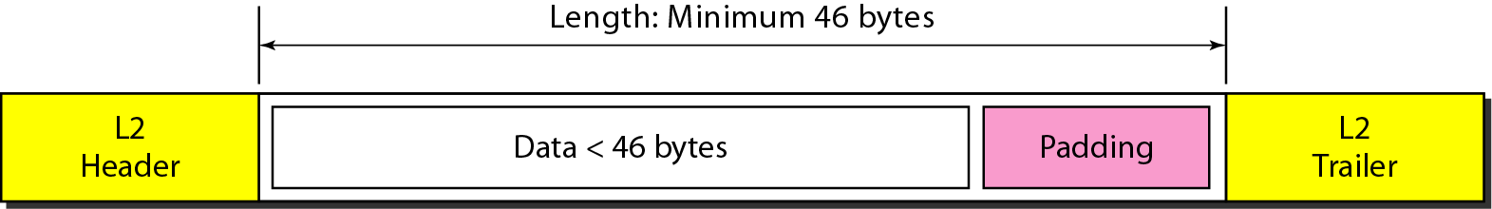
Figure Encapsulation of a small datagram in an Ethernet frame

Slide 75
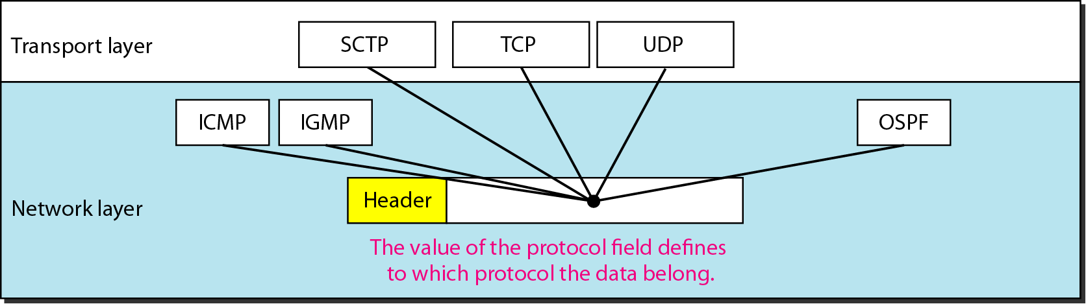
Figure Protocol field and encapsulated data

Slide 76
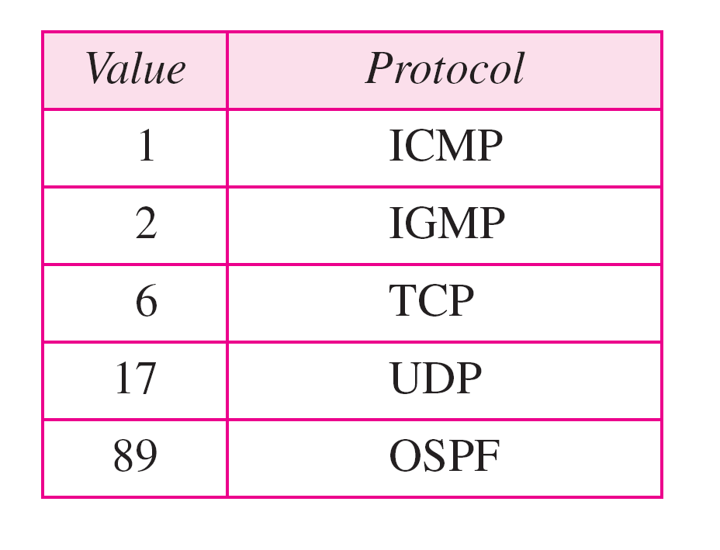
Table Protocol values

Slide 77
Dotted Decimal Notation
IP addresses are written in a so-called dotted decimal notation
Each byte is identified by a decimal number in the range [0..255]:
Example:
10000000
10001111
10001001
10010000
1st Byte
= 128
2nd Byte
= 143
3rd Byte
= 137
4th Byte
= 144
128.143.137.144

Slide 78
Network prefix and Host number
The network prefix identifies a network and the host number identifies a specific host (actually, interface on the network).
How do we know how long the network prefix is?
The network prefix used to be implicitly defined (class-based addressing, A,B,C,D…)
The network prefix now is flexible and is indicated by a prefix/netmask (classless).
network prefix
host number

Slide 79
Classfull IP addresses
When Internet addresses were standardized (early 1980s), the Internet address space was divided up into classes:
Class A: Network prefix is 8 bits long
Class B: Network prefix is 16 bits long
Class C: Network prefix is 24 bits long
Each IP address contained a key which identifies the class:
Class A: IP address starts with “0”
Class B: IP address starts with “10”
Class C: IP address starts with “110”

Slide 81
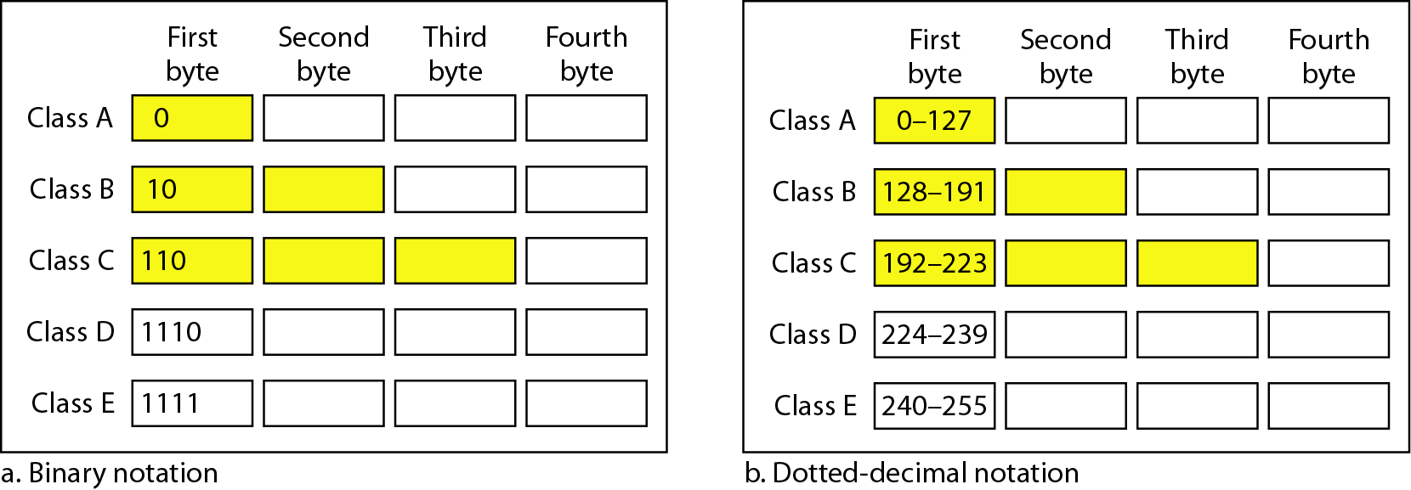
Figure Finding the classes in binary and dotted-decimal notation

Slide 82
Table Subnet masks for classfull addressing

Slide 83
Example
Change the following IPv4 addresses from binary notation to dotted-decimal notation.
Solution
We replace each group of 8 bits with its equivalent decimal number (see Appendix B) and add dots for separation.

Slide 84
Example
Change the following IPv4 addresses from dotted-decimal notation to binary notation.
Solution
We replace each decimal number with its binary equivalent (see Appendix B).

Slide 85
Example
Find the error, if any, in the following IPv4 addresses.
Solution
a. There must be no leading zero (045).
b. There can be no more than four numbers.
c. Each number needs to be less than or equal to 255.
d. A mixture of binary notation and dotted-decimal notation is not allowed.

Slide 86
Example
Find the class of each address.
a. 00000001 00001011 00001011 11101111
b. 11000001 10000011 00011011 11111111
c. 14.23.120.8
d. 252.5.15.111
Solution
a. The first bit is 0. This is a class A address.
b. The first 2 bits are 1; the third bit is 0. This is a class C address.
c. The first byte is 14; the class is A.
d. The first byte is 252; the class is E.

Slide 87
Table Number of blocks and block size in classfull IPv4 addressing

Slide 88
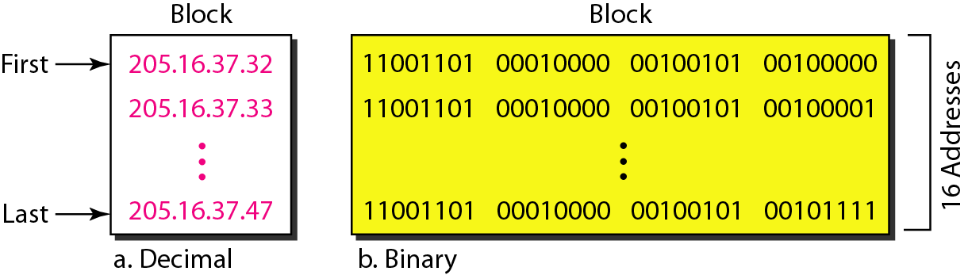
Figure A block of 16 addresses granted to a small organization

Slide 89
Problems with Classful IP Addresses
The original classful address scheme had a number of problems
Problem 1. Too few network addresses for large networks
Class A and Class B addresses are gone
Problem 2. Two-layer hierarchy is not appropriate for large networks with Class A and Class B addresses.
Fix #1: Subnetting
Problem 3. Inflexible. Assume a company requires 2,000 addresses Class A and B addresses are overkill Class C address is insufficient (requires 8 Class C addresses)
Fix #2: Classless Interdomain Routing (CIDR)
Problem 4: Exploding Routing Tables: Routing on the backbone Internet needs to have an entry for each network address. In 1993, the size of the routing tables started to outgrow the capacity of routers.
Fix #2: Classless Interdomain Routing (CIDR)

Slide 90
Problem 5. The Internet is going to outgrow the 32-bit addresses
Fix #3: IP Version 6

Slide 91
Subnetting
Problem: Organizations have multiple networks which are independently managed
Solution 1: Allocate an address for each network
Difficult to manage
From the outside of the organization, each network must be addressable ie have an identifiable address.
Solution 2: Add another level of hierarchy to the IP addressing structure
University Network
Engineering
School
Medical
School
Library
Subnetting

Slide 92
Basic Idea of Sub netting
Split the host number portion of an IP address into a subnet number and a (smaller) host number.
Result is a 3-layer hierarchy
Then:
Subnets can be freely assigned within the organization
Internally, subnets are treated as separate networks
Subnet structure is not visible outside the organization
network prefix
host number
network prefix
subnet number
host number
extended network prefix

Slide 93
Subnet Masks
Routers and hosts use an extended network prefix (subnet mask) to identify the start of the host numbers

Slide 94
Example of a Subnetting Plan
Internet
Subnet 128.49.0.0/24
Subnet 1
34=00000000
Subnet 128.49.1.0/25
Subnet 3
Router
R
Subnet 128.49.1.128/25
Subnet 4
132=10000000
Subnetwork: 128.49.1.0/24
Subnet 2
Subnet 128.49.3.0/24
2 bytes available for subnetting
IP Network: 128.49.0.0/16

Slide 95
Subnetting Example
Subnet | Network bits | Total number of host
255.255.255.0 | /24 | 254
255.255.255.128 | /25 | 126
255.255.255.192 | /26 | 62
255.255.255.224 | /27 | 30
255.255.255.240 | /28 | 14
255.255.255.248 | /29 | 6
255.255.255.252 | /30 | 2

Slide 96
Subnetting Example
An organization with 4 departments has the following IP address space: 192.168.1.0/24. As the systems manager, you are required to create subnets to accommodate the IT needs of 4 departments. The subnets have to support to 100, 50, 25, and 05 hosts respectively. What are the 4 subnet network numbers?
Solution:
192.168.1.0/25 (255.255.255.128) total 126 ip
192.168.1.0/26 (255.255.255.192) total 62 valid ip
192.168.1.0/27.(255.255.255.224) total 30 ip
192.168.1.0/29. (255.255.255.248) total 6 ip

Slide 97
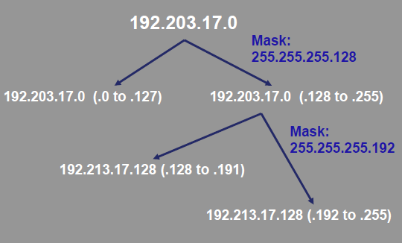

Slide 98
CIDR rule
All IP address should be continuous.
It must be of 2^n.
First IP address in the block should be entirely divided by size of block.
For example: 100.1.2.32 to 100.1.2.47

Slide 99
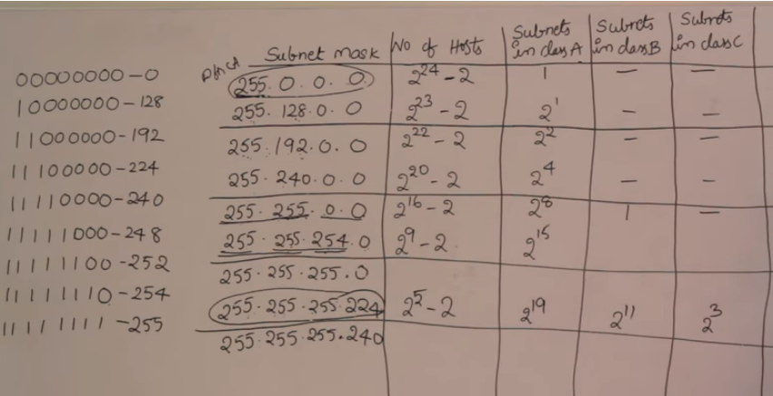

Slide 100
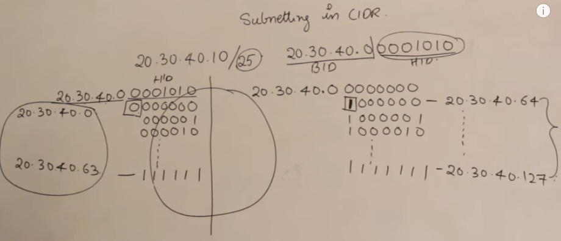

Slide 101
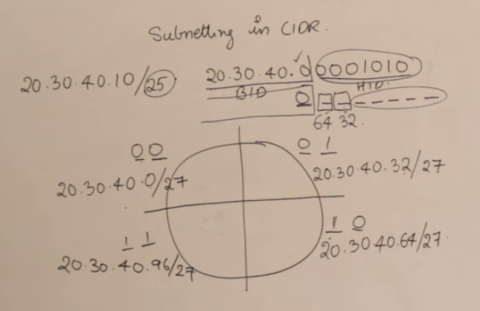

Slide 102
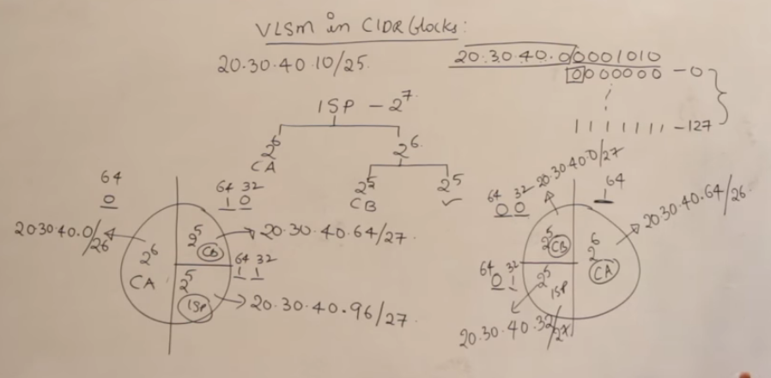

Slide 103
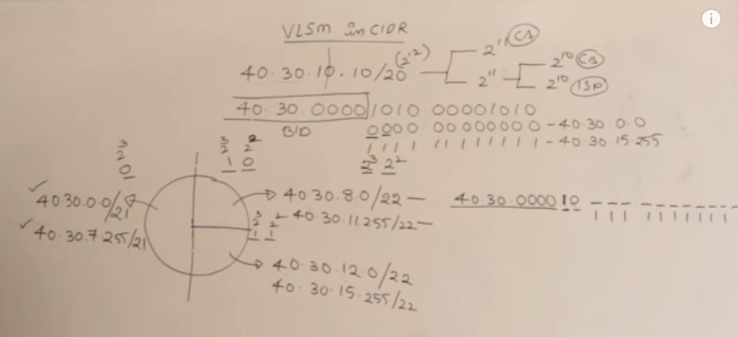

Slide 104
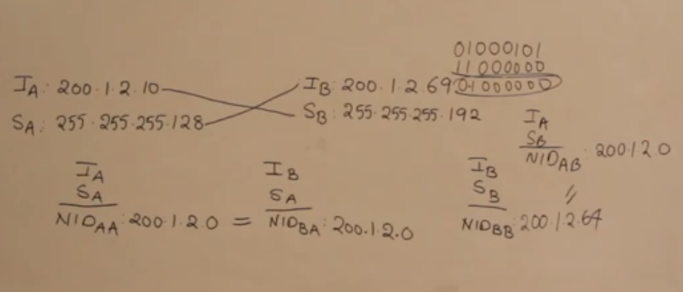
How to find ip is on same network or not
Perform AND operation of Ip of A with subnet of B for network id.
To find network id of A or B. perform AND operation with Ia and Sa.

Slide 105
Advantages of Subnetting
With subnetting, IP addresses use a 3-layer hierarchy:
Network
Subnet
Host
Improves efficiency of IP addresses by not consuming an entire address space for each physical network.
Reduces router complexity. Since external routers do not know about subnetting, the complexity of routing tables at external routers is reduced.

Slide 106
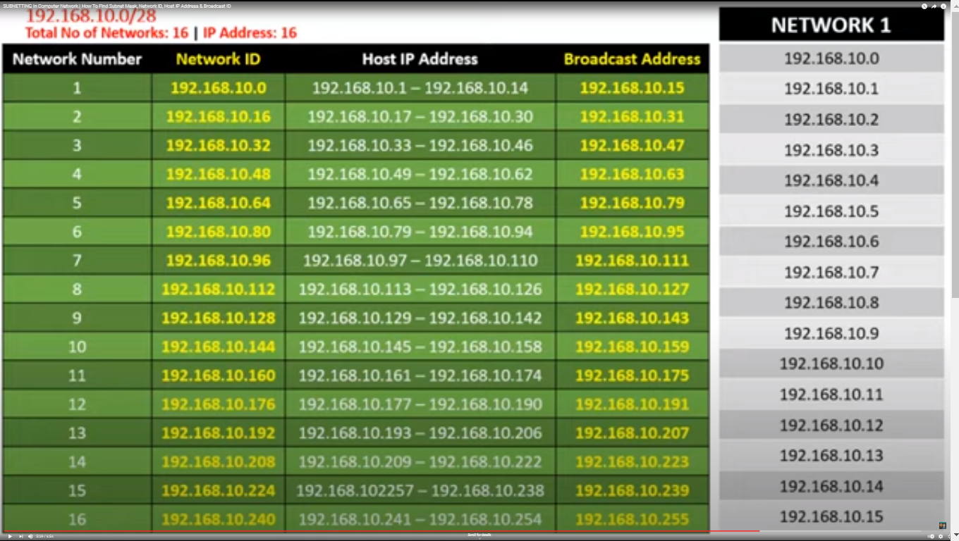

Slide 107

Network without subnets
128.143.0.0/16

Slide 108

Same Network with Subnets

Slide 109
CIDR: Prefix Size vs. Host Space
CIDR Block Prefix # of Host Addresses
/27 32 hosts
/26 64 hosts
/25 128 hosts
/24 256 hosts
/23 512 hosts
/22 1,024 hosts
/21 2,048 hosts
/20 4,096 hosts
/19 8,192 hosts
/18 16,384 hosts
/17 32,768 hosts
/16 65,536 hosts
/15 131,072 hosts
/14 262,144 hosts
/13 524,288 hosts

Slide 110
In IPv4 addressing, a block of addresses can be defined as
x.y.z.t /n
in which x.y.z.t defines one of the addresses and the /n defines the mask.

Slide 111
The first address in the block can be found by setting the rightmost 32 − n bits to 0s.

Slide 112
Example
A block of addresses is granted to a small organization. We know that one of the addresses is 205.16.37.39/28. What is the first address in the block?
Solution
The binary representation of the given address is
11001101 00010000 00100101 00100111
If we set 32−28 rightmost bits to 0, we get
11001101 00010000 00100101 00100000
or 205.16.37.32

Slide 113
The last address in the block can be found by setting the rightmost 32 − n bits to 1s.

Slide 114
Example
Find the last address for the block in previous example.
Solution
The binary representation of the given address is
11001101 00010000 00100101 00100111
If we set 32 − 28 rightmost bits to 1, we get
11001101 00010000 00100101 00101111
or
205.16.37.47

Slide 115
The number of addresses in the block can be found by using the formula 2^{32−n}.

Slide 116
Example
Find the number of addresses in previous example
Solution
The value of n is 28, which means that number of addresses is 2 ³²⁻²⁸ or 16.

Slide 117
IPv6
IP Version 6
Is the successor to the currently used IPv4
Specification completed in 1994
Makes improvements to IPv4 (no revolutionary changes)
One (not the only !) feature of IPv6 is a significant increase in size of the IP address to 128 bits (16 bytes)
IPv6 will solve – for the foreseeable future – the problems with IP addressing

Slide 118

Figure IPv6 datagram header and payload

Slide 119

Figure Format of an IPv6 datagram

Slide 120
IPv6 Header
Version: it is the version number of IP
Priority: it is 4 bit filed defines the priority of the packet with respect to traffic congestion
Flow Label: it is a 3 byte field that is designed to provide special handling for particular flow of data.
Payload length: it is 2 byte defines the length of the ip datagram excluding the base header
Next header: it is an 8 bit field defining the header that follows base header.
Hop limit: it is 8 bit hop limit like TTL in ipv4.
Source address and destination address: 16 byte (128 bit) internet adders that identifies the original source and destination.

Slide 121
IPv6 Provider-Based Addresses
The first IPv6 addresses will be allocated to a provider-based plan
Type: Set to “010” for provider-based addresses
Registry: identifies the agency that registered the address
The following fields have a variable length (recommeded length in “()”)
Provider: Id of Internet access provider (16 bits)
Subscriber: Id of the organization at provider (24 bits)
Subnetwork: Id of subnet within organization (32 bits)
Interface: identifies an interface at a node (48 bits)
010
Registry ID
Provider ID
Subscriber ID
Subnetwork ID
Interface ID

Slide 122
Table Next header codes for IPv6

Slide 123

Table Comparison between IPv4 and IPv6 packet headers

Slide 124
Thank You

